Slide 1

Wired and Wireless Communication Standards
Associate Professor
Department of Computer Science and Engineering

Slide 2
Session Objectives
After completion of the session you will be able to understand
The project 802 for standard
IEEE Ethernet Standards 802.2, 802.5
Ethernet Frame format for communication
Wireless Standard for Communication, 802.11
Wireless frame format for communication

Slide 3

Introduction
In 1985, the Computer Society of the IEEE started a project, called Project 802.
The objective was to set standards to enable intercommunication among equipment from a variety of manufacturers.
Project 802 does not seek to replace any part of the OSI model or TCP/IP protocol suite. Instead, it is a way of specifying functions of the physical layer and the data-link layer of major LAN protocols.

Slide 4

Ethernet Evolution through four Generations
The original Ethernet was created in 1976 at Xerox’s Palo Alto Research Center (PARC).
Since then, it has gone through four generations.: Standard Ethernet (10 Mbps), Fast Ethernet (100 Mbps), Gigabit Ethernet (1 Gbps), and 10 Gigabit Ethernet (10 Gbps)

Slide 5
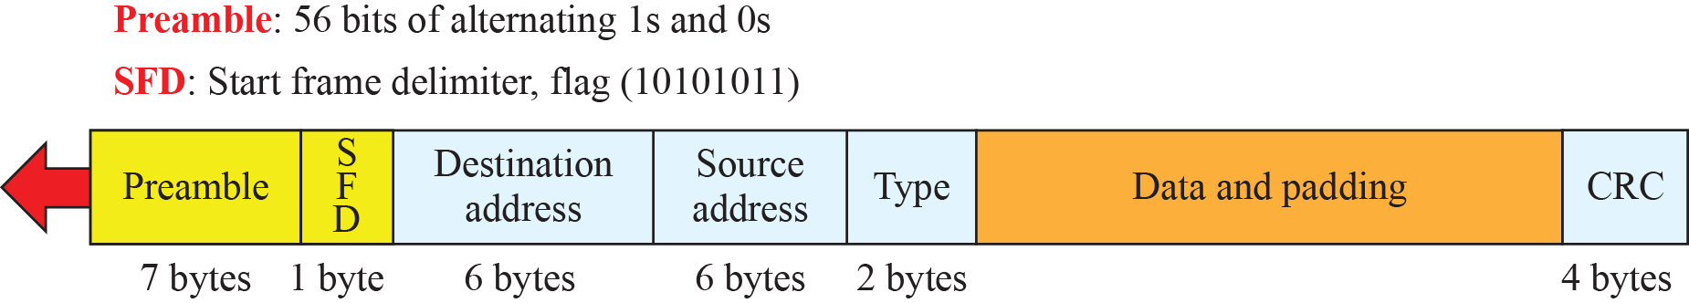
Standard Ethernet (10Mbps)
The original Ethernet technology with the data rate of 10 Mbps is called as the Standard Ethernet.
Examples: 10Base2, 10Base5, 10Base T, 10Base F
The frame format is shown in figure below.
Notes:
Preamble: This is a pattern of alternative 0's and 1's which indicates starting of the frame and allow sender and receiver to establish bit synchronization.
Start of frame delimiter (SFD) – This is a 1-Byte field which is always set to 10101011. SFD indicates that upcoming bits are starting of the frame, which is the destination address.
Destination Address – This is 6-Byte field which contains the MAC address of machine for which data is destined.
Source Address – This is a 6-Byte field which contains the MAC address of source machine. As Source Address is always an individual address (Unicast), the least significant bit of first byte is always 0.
Cyclic Redundancy Check (CRC) – CRC is 4 Byte field. This field contains a 32-bits hash code of data, which is generated over the Destination Address, Source Address, Length, and Data field. If the checksum computed by destination is not the same as sent checksum value, data received is corrupted.

Slide 6
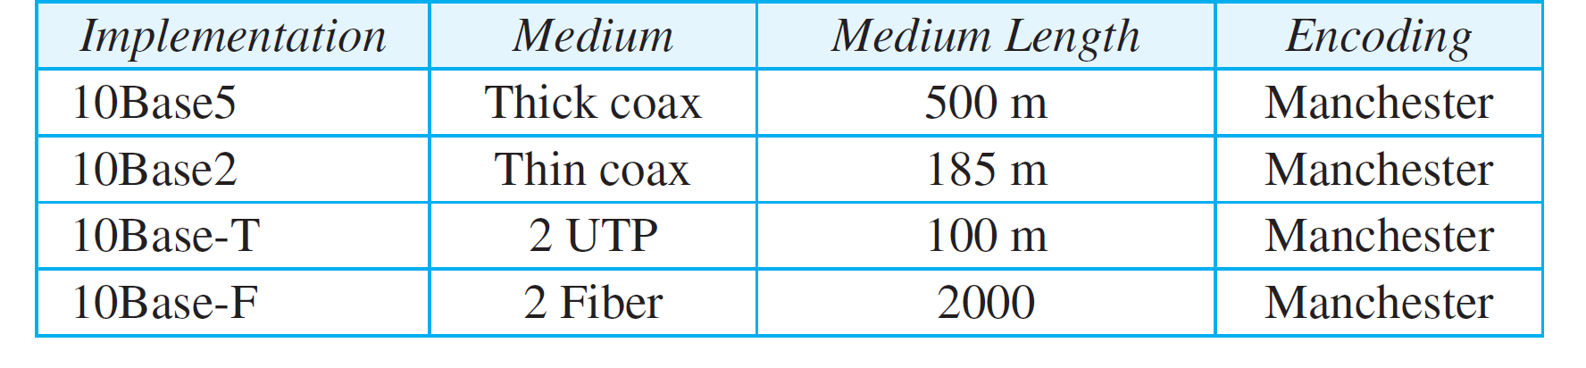
Summary of Standard Ethernet Implementation

Slide 7
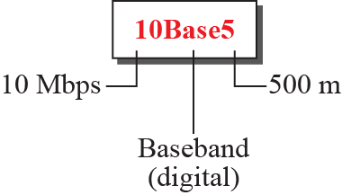
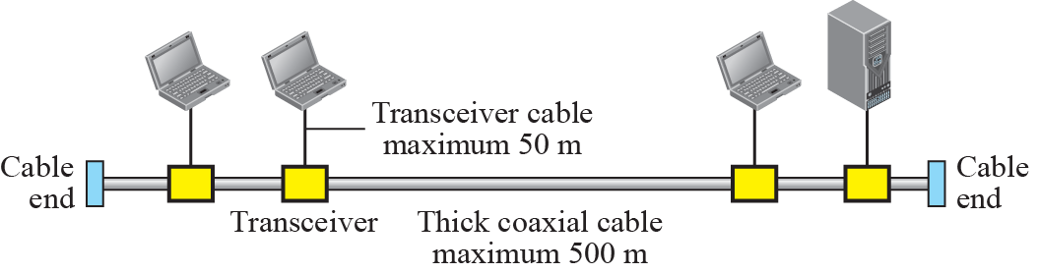
10Base5 Ethernet Implementation

Slide 8
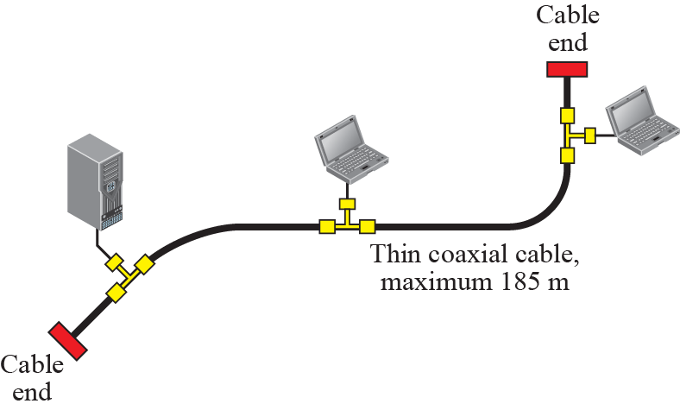
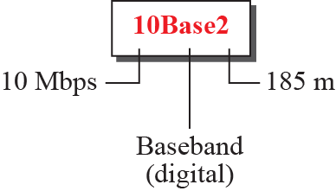
10Base2 Ethernet Implementation

Slide 9
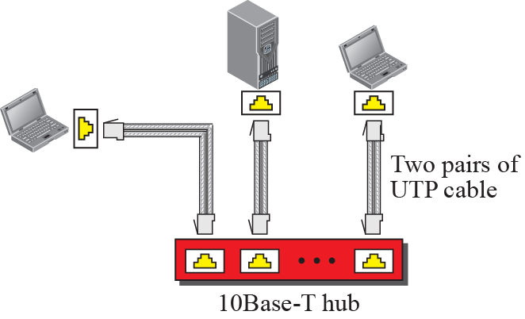
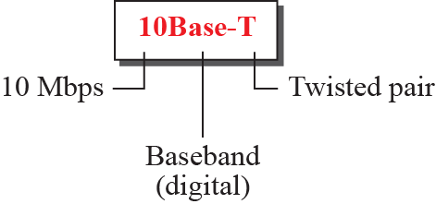
10Base T Ethernet Implementation

Slide 10
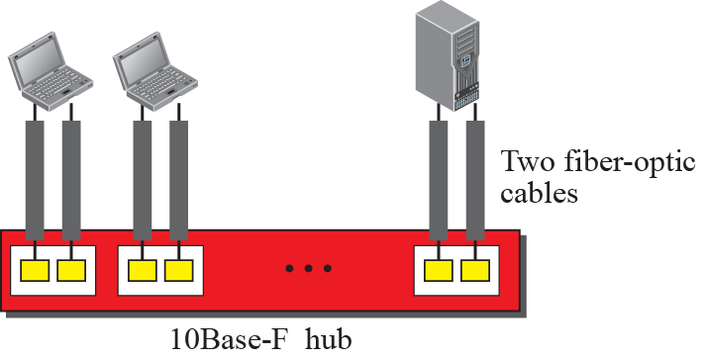
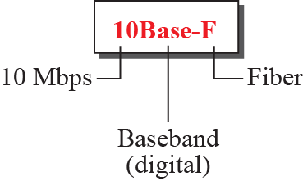
10Base F Ethernet Implementation

Slide 11

Fast Ethernet Standard (100Mbps)
In the 1990s, Ethernet transmission rate increased to 100 Mbps, and called generation of Fast Ethernet.
The designers of the Fast Ethernet needed to make it compatible with the Standard Ethernet.
The MAC sublayer was left unchanged and the features of the Standard Ethernet that depend on the transmission rate, had to be changed.

Slide 12
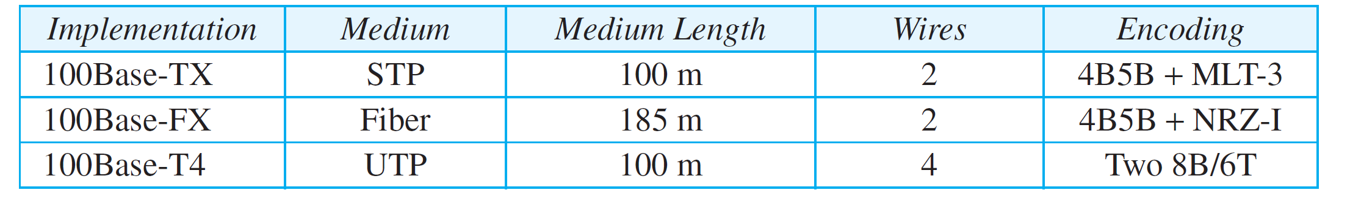
Summary of Fast Ethernet Standard Implementation

Slide 13

Fast Ethernet Standard Implementation

Slide 14
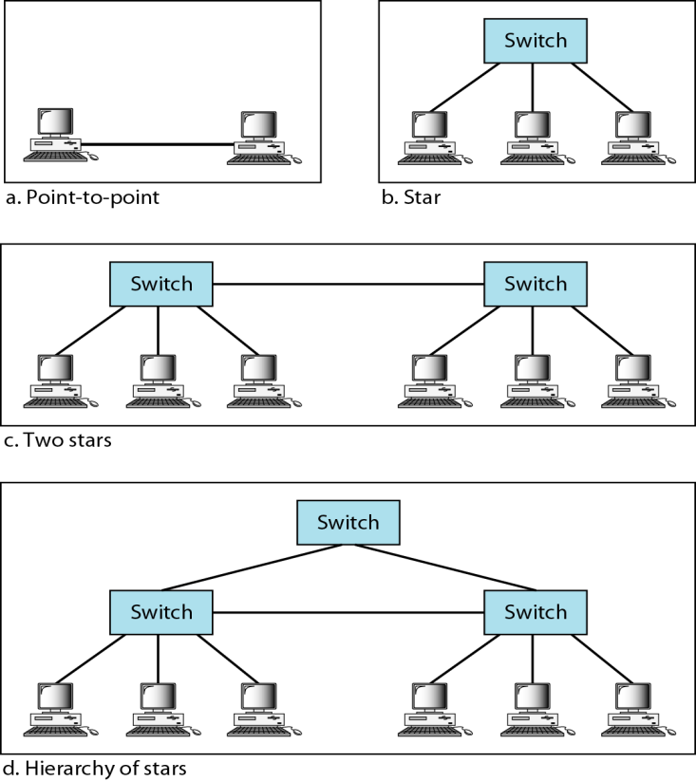
Gigabit Ethernet Standard (1Gbps)
The goals of the Gigabit Ethernet were to upgrade the data rate to 1 Gbps.
Challenge was to keep the address length, the frame format, and the maximum and minimum frame length the same.
The IEEE committee calls it the Standard 802.3z.
The standard is compatible with high speed fiber optical communication.
Gigabit Ethernet has two distinctive approaches for medium access: half-duplex and full-duplex.

Slide 15
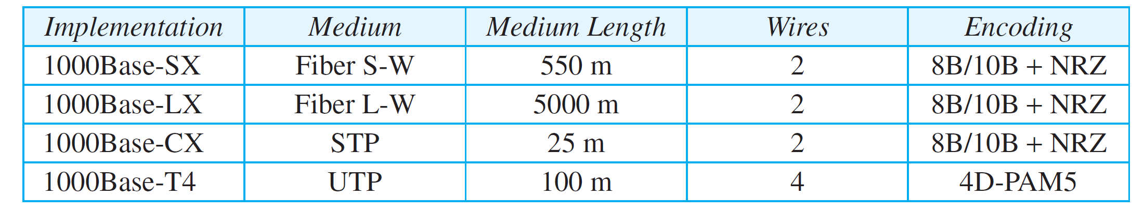
Gigabit Ethernet Standard Implementation
Notes:
Fiber S-W : short wave
Fiber L-W: long wave

Slide 16
Gigabit Ethernet Standard (10Gbps)
The idea is to extend the technology, the data rate, and the coverage distance so that the Ethernet can be used as LAN and MAN (metropolitan area network).
The IEEE committee called it Standard 802.3ae.
It operates only in full-duplex mode, which means there is no need for contention.
Four implementations are the most common: 10GBase-SR, 10GBase-LR, 10GBase-EW, and 10GBase-X4.

Slide 17
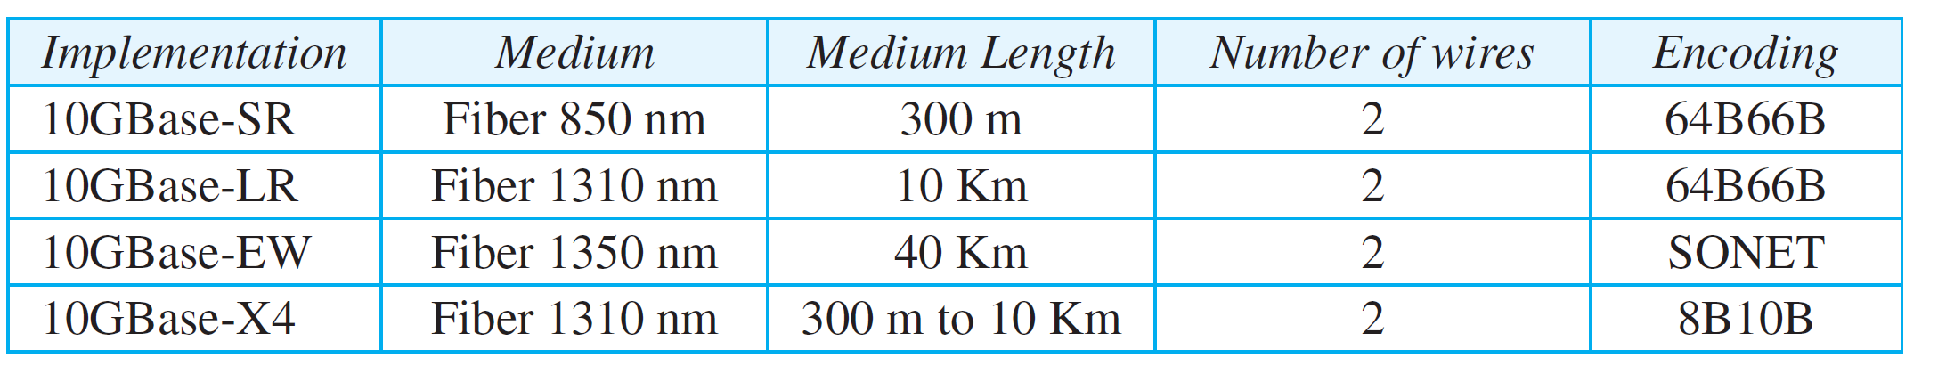
10 Gigabit Ethernet Standard Implementation

Slide 18
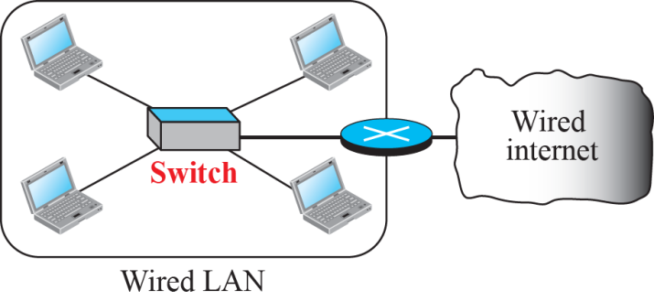
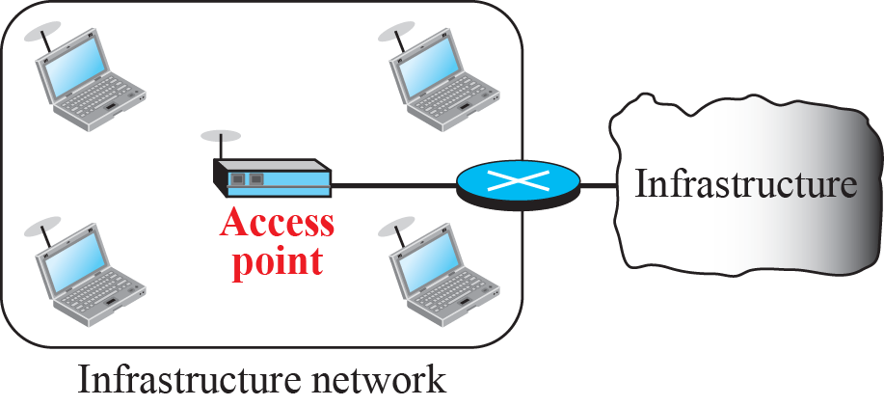
Wireless LAN Standard 802.11
Wireless communication is one of the fastest-growing technologies.
The demand for connecting devices without the use of cables is increasing everywhere.
Wireless LANs can be found on college campuses, in office buildings, and in many public areas.
IEEE has defined the specifications for a wireless LAN, called IEEE 802.11.
It covers the physical and data-link layers.
The public uses the term WiFi (short for wireless fidelity) as a synonym for wireless LAN.
The difference between wire and wireless LAN is shown in the figure below:

Slide 19
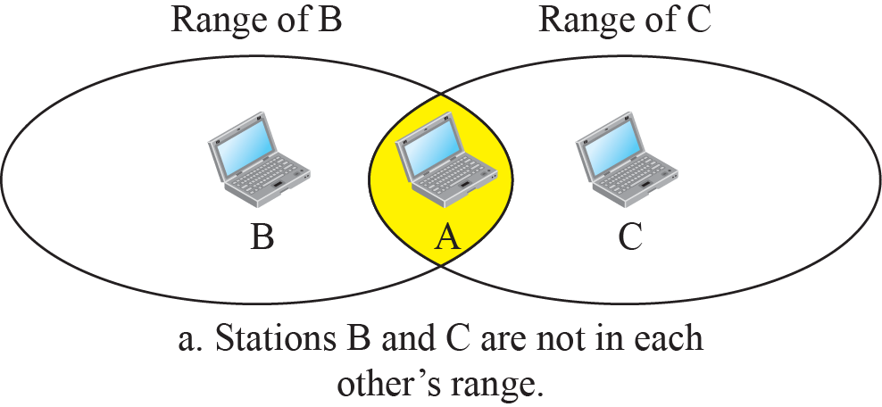
Wireless LAN Challenges
Access Control - how a wireless host can get access to the shared medium (air).
The CSMA/CD algorithm does not work in wireless LANs for three reasons:
  Wireless hosts do not have enough power to send and receive at the same time.
  The hidden station problem prevents collision detection
  The distance between stations can be great.
  The hidden and exposed terminal problem.

Slide 20
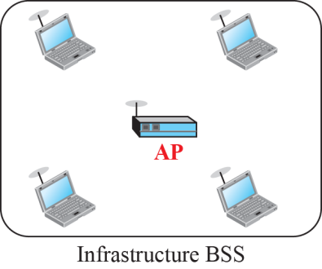
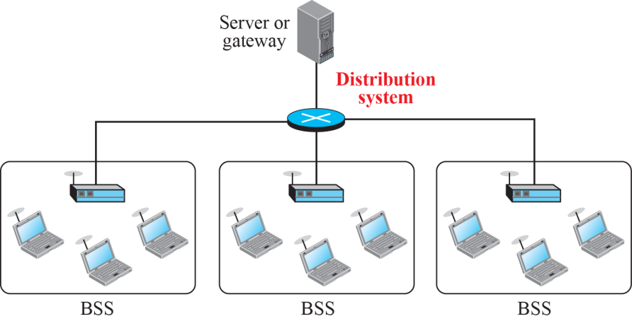
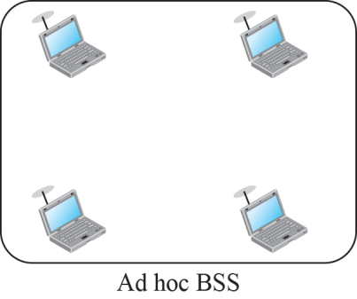
Wireless LAN Architecture
The standard defines two kinds of services: the basic service set (BSS) and the extended service set (ESS).
Extended service set (ESS)

Slide 21
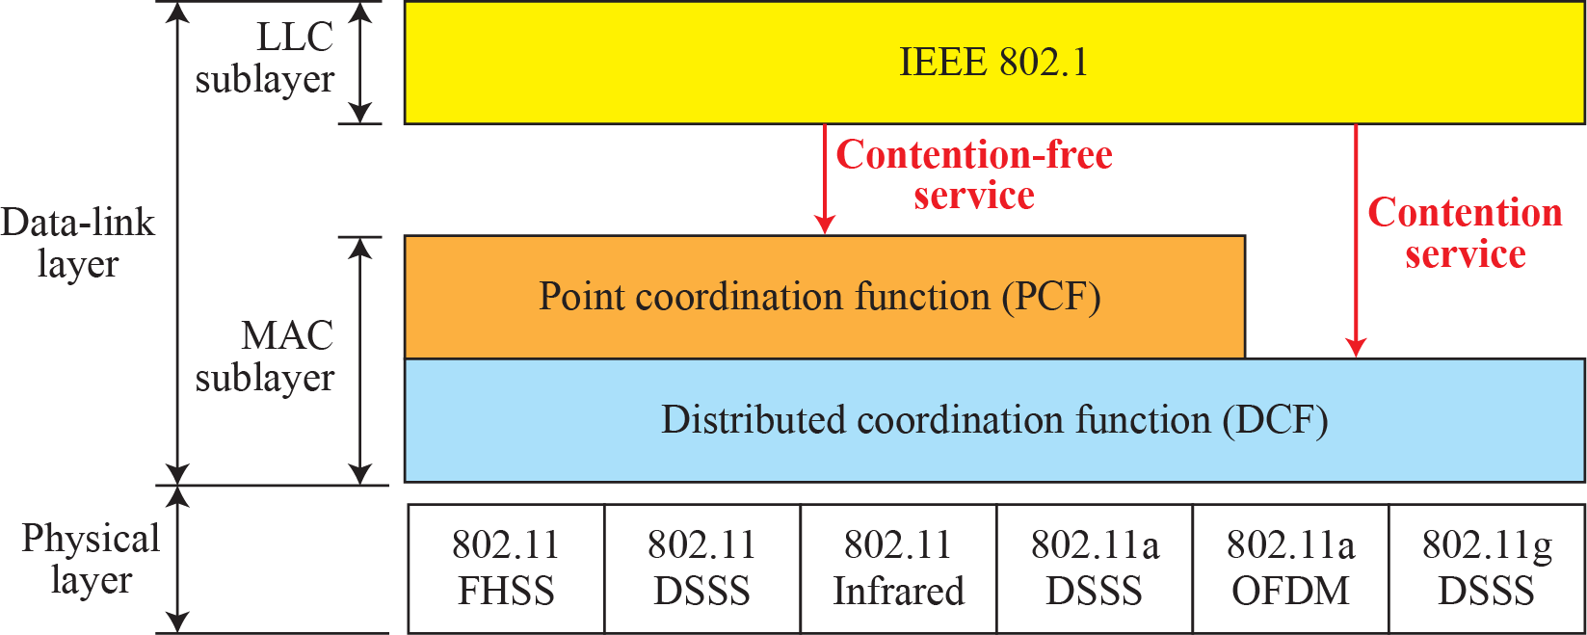
MAC Layer in 802.11 Standard
IEEE 802.11 defines two MAC sublayers: the distributed coordination function (DCF) and point coordination function (PCF).
Figure below shows the relationship between the two MAC sublayers, the LLC sublayer, and the physical layer.
Notes:
DCF : uses CSMA/CA for collision detection
PCF: allow sharing of medium without contention

Slide 22

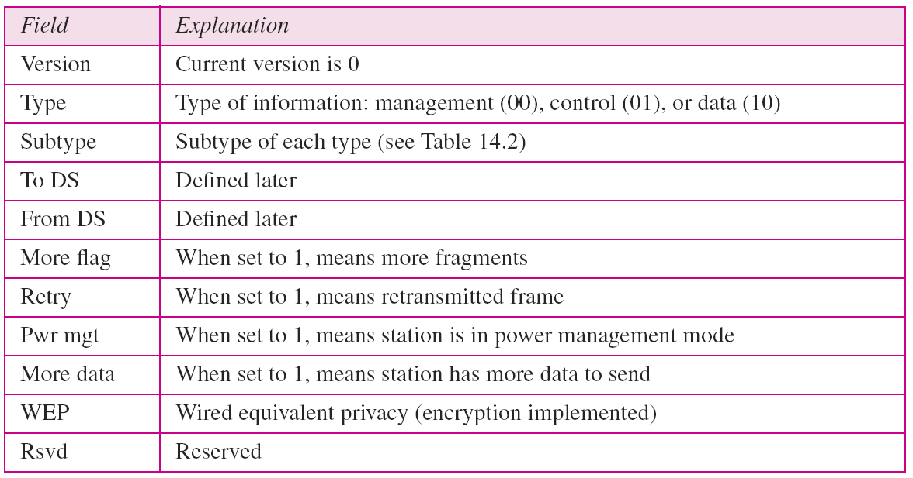
802.11 Frame Format

Slide 23
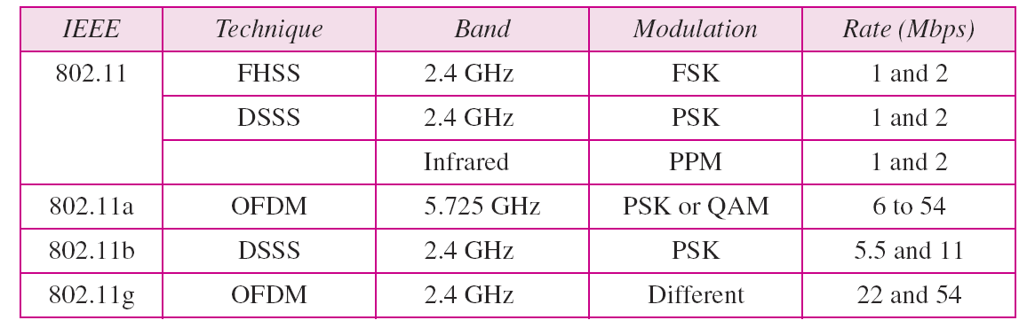
Various 802.11 Standard

Slide 24
Summary
In this session we have learned
IEEE Ethernet Standards for communication
IEEE Frame format for communication
IEEE Wireless Standard for Communication along with frame format
Challenges associated with Wireless Communication

Slide 25

Notes:
1.#

